Slide 1
Digital Photo Project
Nathan Wagner

Slide 2
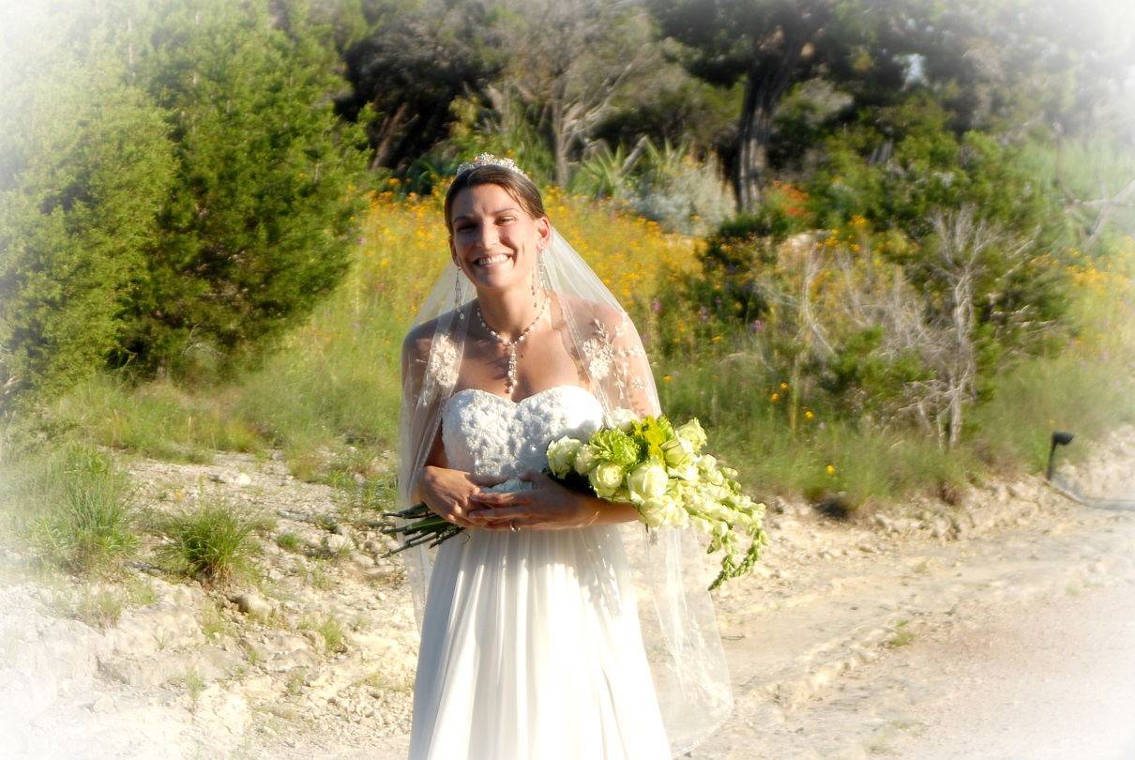
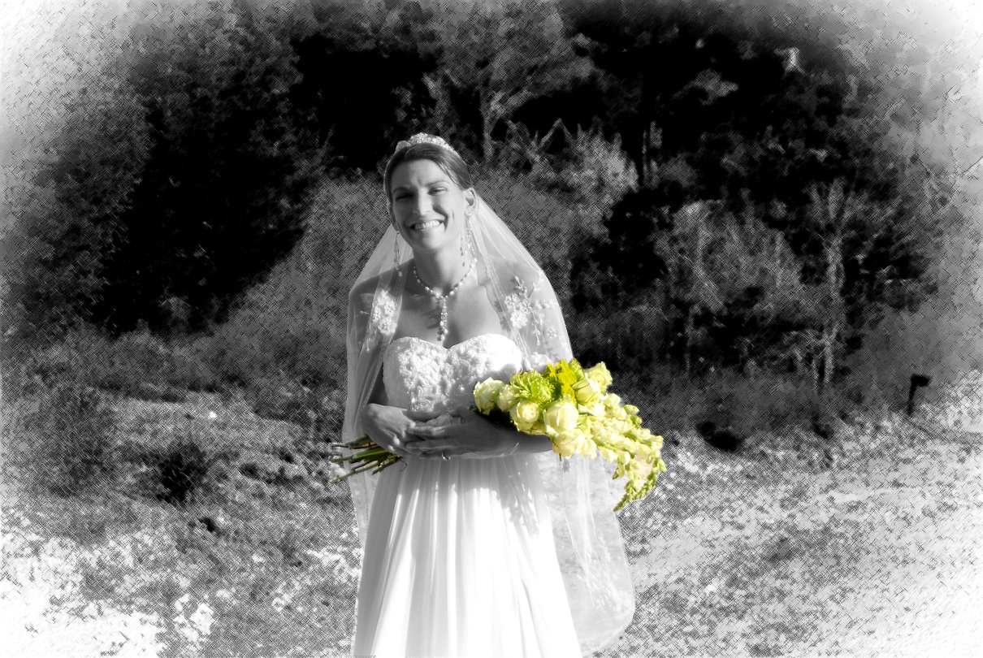
Digital Alterations:
Blur tool was used at 200% mag. to edit lines under eyes and Spot Healing to remove skin blemishes and fix teeth /gum line.
Flower petals (R) and stems (L) cut out for color; contrast/brightness adjustment to pop
Background: Altered to B/W; crosshatch pattern
Bride cut out to be only B/W; no pattern
Notes:
Digital Alterations: Blur Tool to edit the lines under the eyes; Spot Healing Tool to remove skin blemishes and fix teeth/gum line
Entire background made to black and white with a crosshatch filter;
Bride cut out and made in basic B/W to contrast crosshatch;
Separate layers used to keep green of the flowers

Slide 3
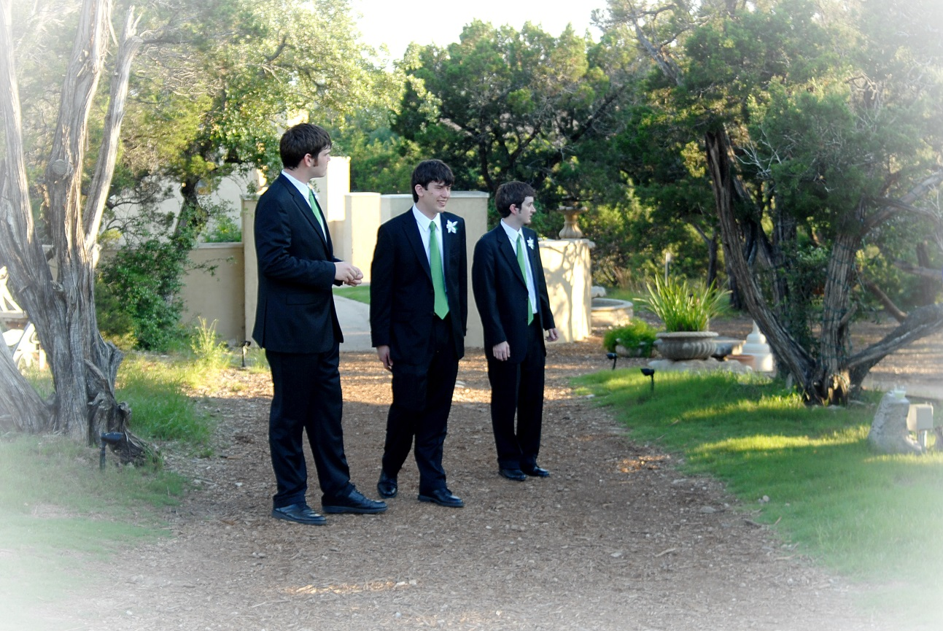
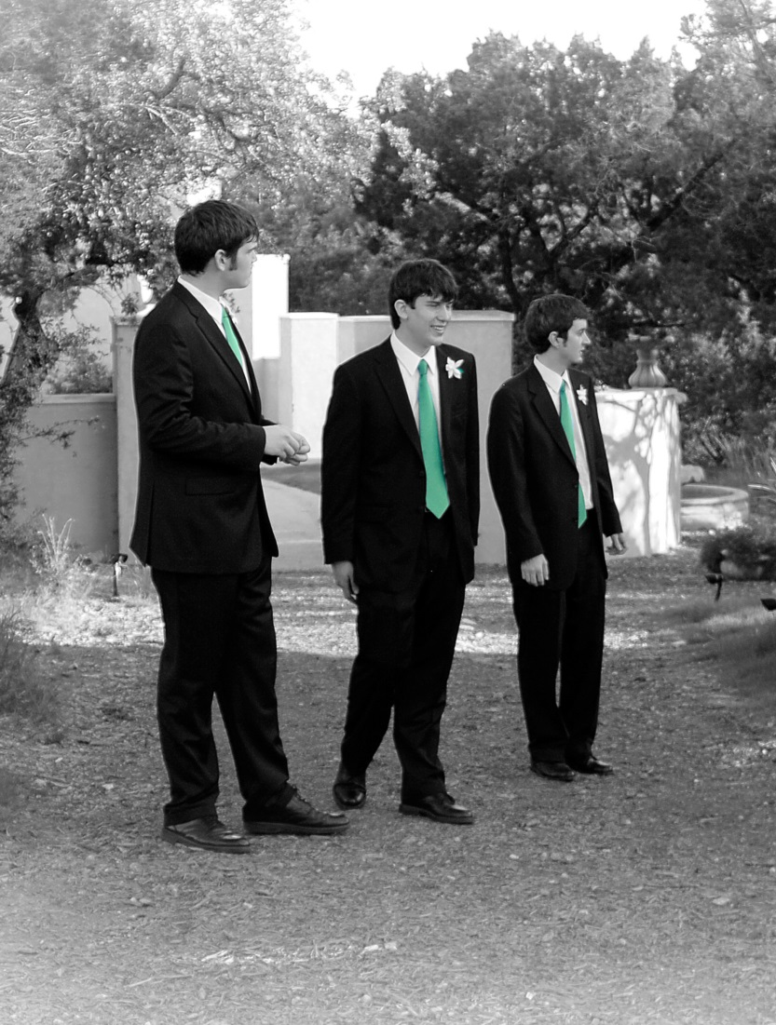
Digital Alterations:
Spot Healing was used at 200% mag. to remove skin blemishes
Background: Altered to B/W; no pattern
Ties cut out to maintain green
Picture cropped to focus on men
Notes:
Original photo cropped to cut out extra info; Ties colored while rest made to black and white

Slide 4
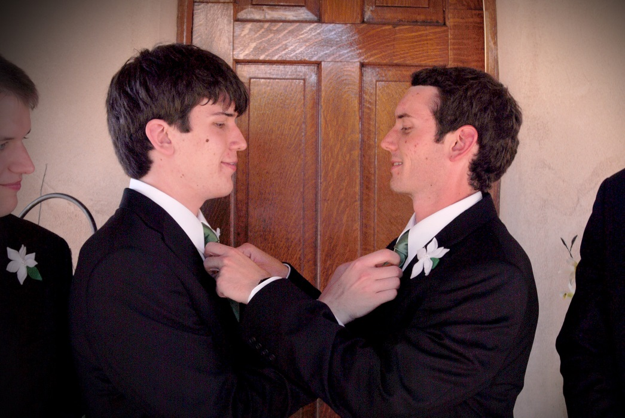
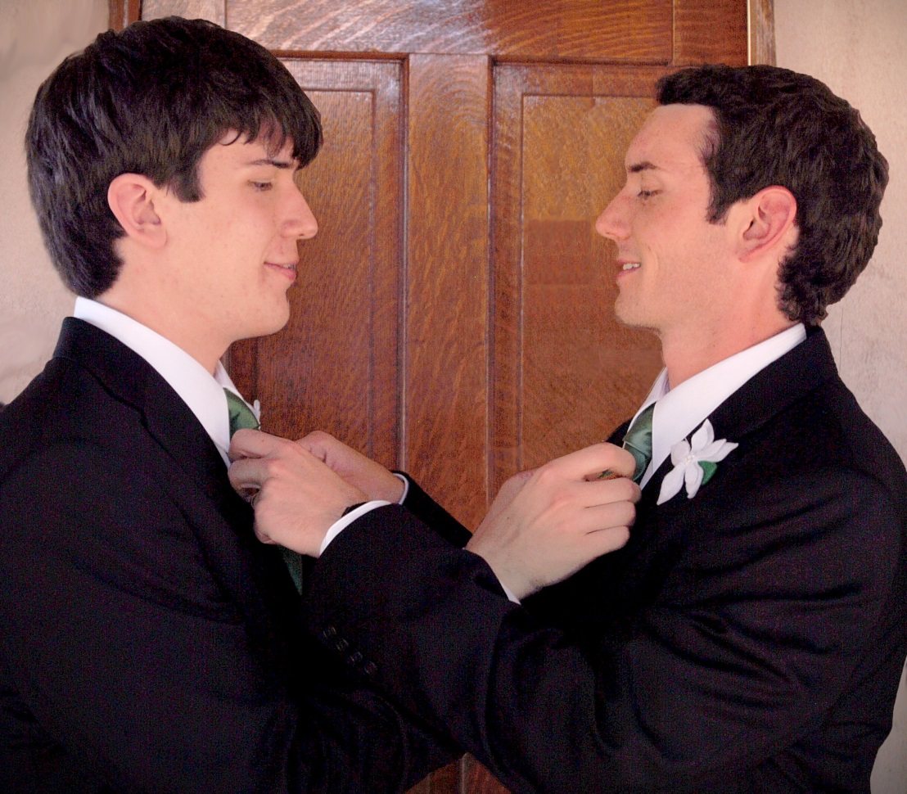
Digital Alterations:
Spot Healing was used at 200% mag. to remove skin blemishes.
Picture cropped to cut out other people.
On thing that always bothered me was the door not centered, so I moved the two people to make the door centered, then I had to recreate the door piece-by-piece.
Teeth whitened, and sunburned faces lightened; skin tone adjusted.
Notes:
On thing that always bothered me was the door not centered, so I moved the two people to make the door centered, then I had to recreate the door piece-by-piece. Teeth whitened, and sunburned faces lightened.

Slide 5
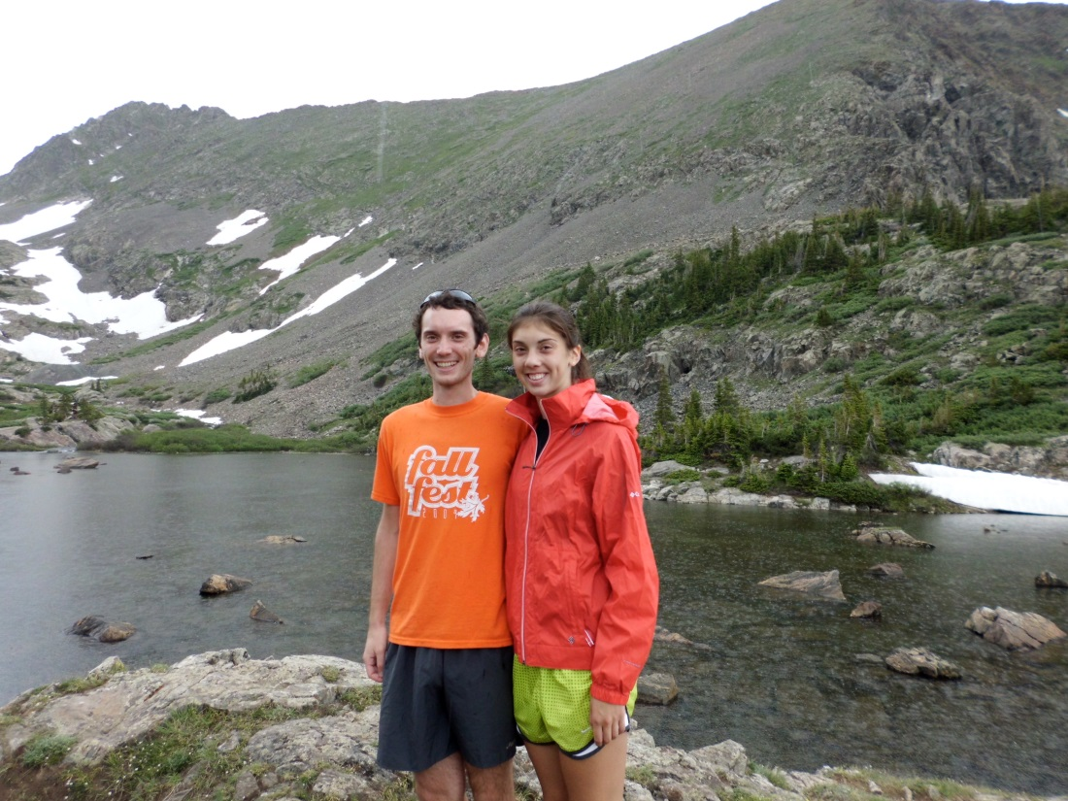
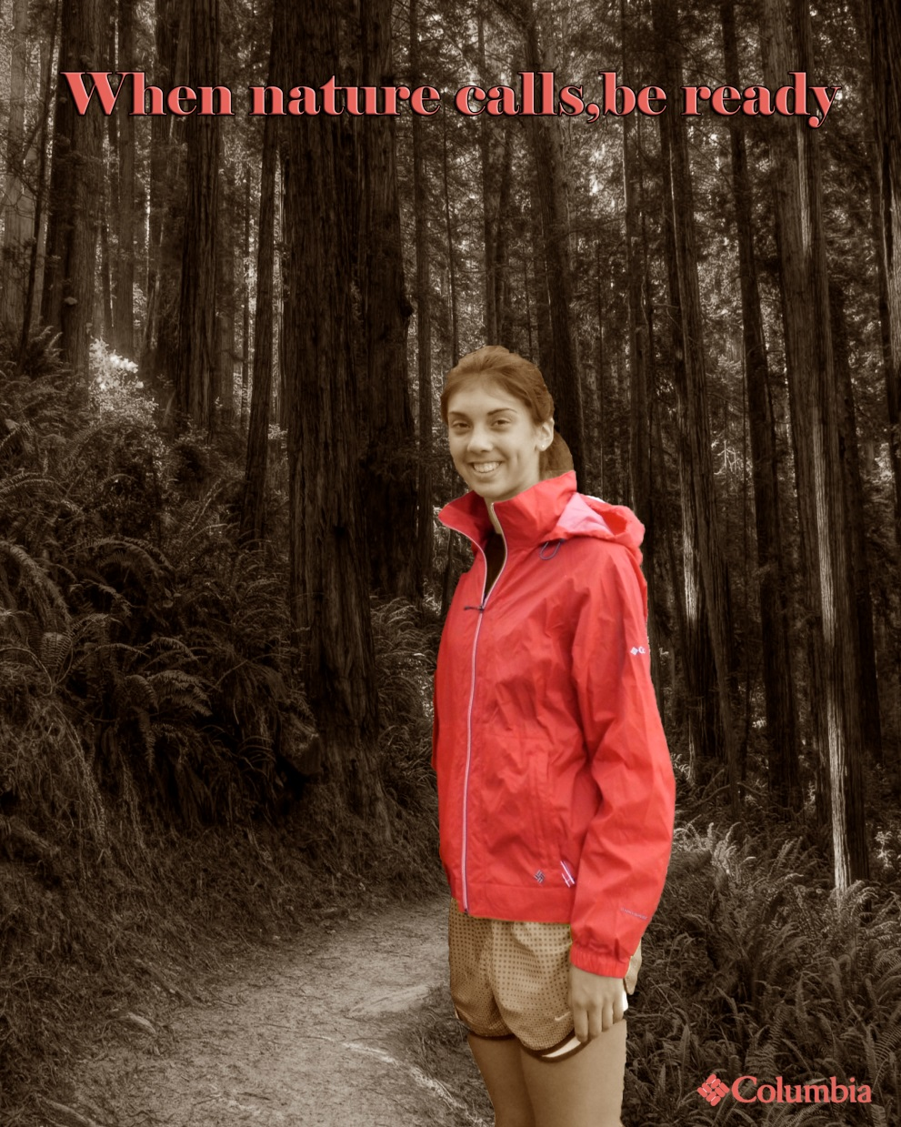
Background: My sister was removed from my side and Colorado, transferred to the California redwoods.
The original redwoods were in color, but I changed to sepia. The red jacket was highlighted in color.
I added the Columbia logo, matching the jacket color. Then I added a catchphrase.

Slide 6
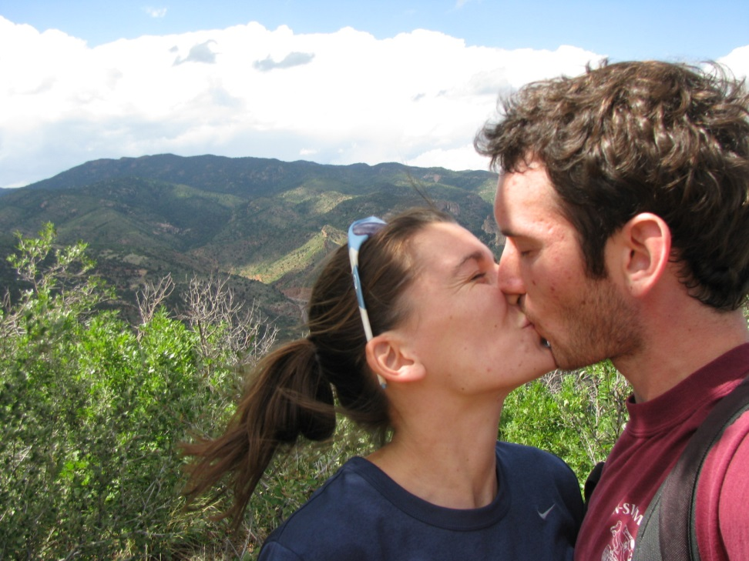
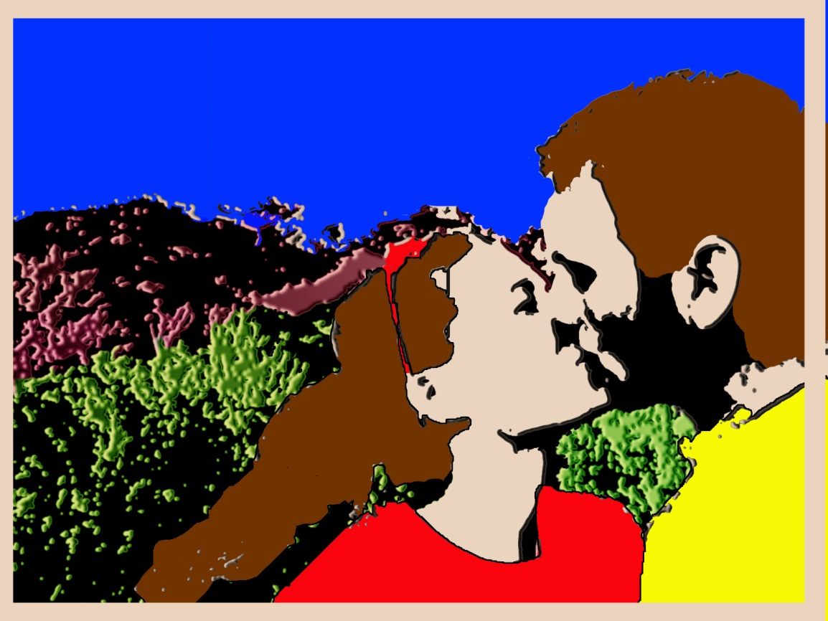
Inspired by Roy Lichtenstein, this is Pop Kiss. Entire photo was covered with a plaster filter. Different sections were copied out to layer with color.
Bushes and mountains were adjusted through the color balance. The rest of the clothing and hair was filled with solid color. Shirt colors changed to capture the primary colors. Stroke was applied to the clothing.

